Slide 1
Space Apps challenge Cleveland Data treasure hunting
Brian grady
Matthew wadsworth
Michael Stratton

Slide 2
Original problem statement
Huge amounts of (intn’l) governmental data available world wide
http://data.nasa.gov/
Very Cool!
Poor/Inconsistent meta data prevents easy searching
Islands of very useful and interesting data that are difficult to make practical use of
Find a solution! Let’s enable technical and less technical users and unlock the power of open source
ToolKit provided example data sources

Slide 3
Unpacking the problem
Large amounts of data.. BIG DATA #BuzzWord
Different sources like gov’t agencies or scientific research (NASA, Autralia, NY State). This resulted in…
Climate data next to Horse Racing Licenses?
Foreign data sets had different access methods or even restricted access!
Some very useful human readable descriptions and meta data

Slide 4
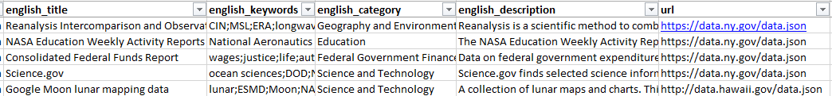
Whats the data look like?
From our ToolKit
It looks like whatever system is in use points to the same NY state json files for Federal Fund Reports and Geographic/Enviornemtn Data?
Let’s pull up the ny.gov json..

Slide 5
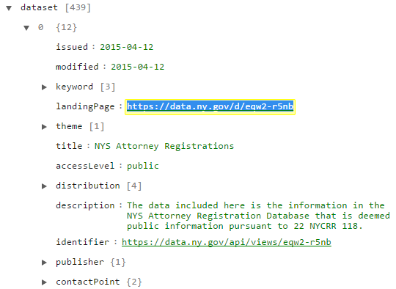
What’s the data look like Cont…
We expand the first data element and find…
Attorneys!
And if we follow the landing page or
Identifier we find a listing of registered
Attorneys
For this example we have to sort through 439
of these entries to find the 1 landing page we want

Slide 6
Our proposed solutions
Word count
Pull the data, parse it, find common USEFUL keywords
Rely on Keyword, Title, Descriptions already provided in data
Site metadata scraper
Pull the sometimes useful metadata descriptions and find USEFUL keywords
Black box systems to expand from keywords found in data
Bing Synonyms, Stanford Natural Language Processing

Slide 7
Word Count
Easiest and fastest to implement
Should be useful
General flow
Provide Json URL’s from ToolKit
Open a network object and Read() into a json data structure
Iterate through each dataset in the json structure, collecting text from ‘keyword’,’title’,’description’,’theme’ fields
Pass text through a word frequency function that stores unique words and the number of occurrences

Slide 8
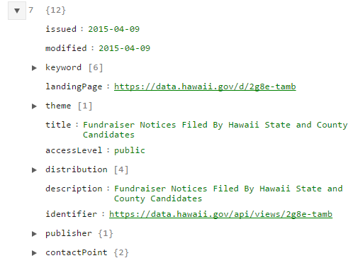
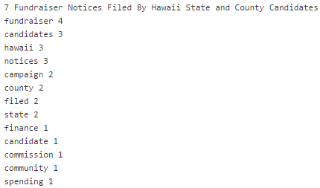
Word count con’t…

Slide 9
Conclusion
This is a large multifaceted problem that will require multiple approaches
Our solution is one piece of this large puzzle
Can be expanded to scan the entire data sets, promising early results
Implementing some of our other proposed solutions will hopefully pull in more keywords which we can push into black box systems (Synonym, Language processing) and increase quality of searching
A more complete final solution will pull from multiple sources, leverage multiple tools, and even support user interaction to suggest or reject key words

